Slide 1

Code Reviews
Best practices
Based on How to Do Code Reviews Like a Human

Slide 2
Why do code reviews
Finding errors and areas of improvement
Can be a great learning tool for both reviewer and reviewee: share knowledge
Increase visibility and understanding of the code and make more informed engineering decisions

Slide 3
It’s not just about bugs…
Code reviews are a social as well as a technical process. Keeping and building a positive relationship with your colleagues is just as important as filtering out errors and making improvements.

Slide 4
Where pull requests can go wrong:
Comments can be easily misinterpreted by author, taken personally, and create tension and discord in teams
Poorly formed review requests can be unnecessarily wasteful of time and energy for both author and reviewer
Issues are missed and bugs make it into the codebase

Slide 5
E.g.
The author perceives the discussion as a personal attack: It’s easy for an author to interpret criticism of their code as an implication that they are an incompetent programmer.
The reviewer is given no context of the change: if there’s insufficient description, the reviewer won’t know what to look for or test.
Time and effort required: reviewing code properly takes cognitive effort, taking the reviewer’s focus and time from what they’re working on.

Slide 6
Tip 1: if a computer can do it, let it
Linting (static code analysis):
White spaces
Trailing commas
Semi colons
Console.logs
Unused imports, etc.
Code formatters: e.g. Prettier
It’s much easier for a computer to find these things, freeing the reviewer to make more meaningful contributions such as commenting on readability, approach, performance implications, future proofing, etc.
Automation also allows the author to discover careless mistakes in seconds instead of hours. The instant feedback makes it easier to learn from and cheaper to fix because the author still has the relevant context in their head.

Slide 7
Tip 2: Choose a style guide and stick to it
Consistency in code style leads to much easier comprehension among teammates, quicker code reviews, and fewer bugs.
Style discussions and opinions don’t belong in a code review as they are subjective and much higher level decisions.
Google style guide: https://google.github.io/styleguide/jsguide.html
AirBnb style guide: https://github.com/airbnb/javascript
… or create your own incrementally and update the Readme.md accordingly ;)

Slide 8
Tip 3: increase request visibility
Go over outstanding pull requests on a regular basis, e.g. daily standup
Use statuses to indicate if it’s blocked, in draft, or ready for review
Set a main reviewer

Slide 9
Tip 4: use a template
Main reviewer: @someone
#### What does this PR do?
#### What are the relevant tickets?
#### Where should the reviewer start?
File name: change
File name: change
#### How should this be manually tested?
If appropriate...
#### Are there any breaking changes?
#### Any background context you want to provide?
#### Screenshots

Slide 10
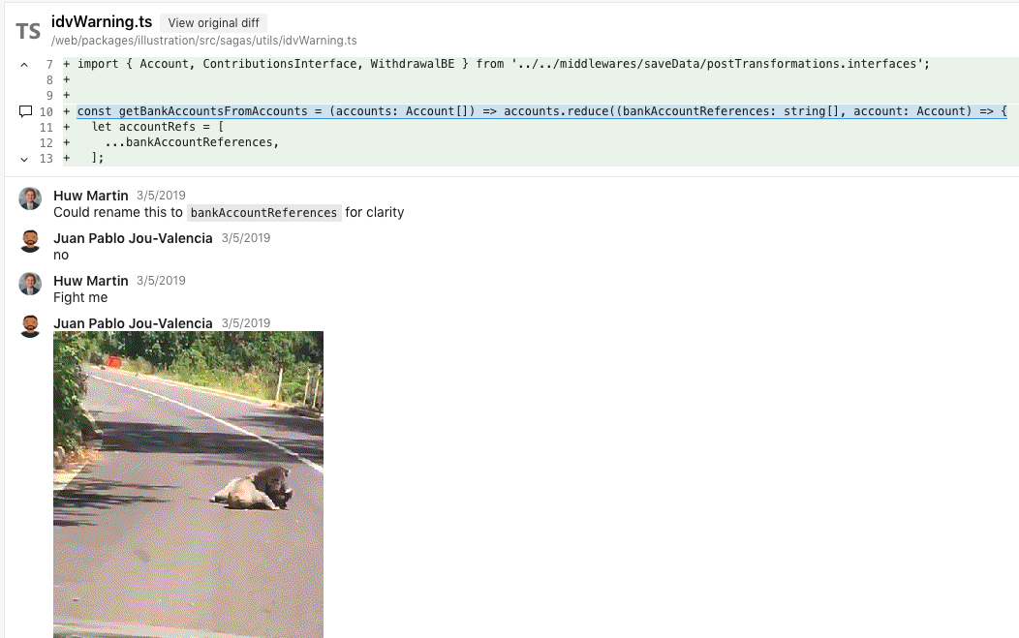
Comment Etiquette tips …to avoid conflict

Slide 11
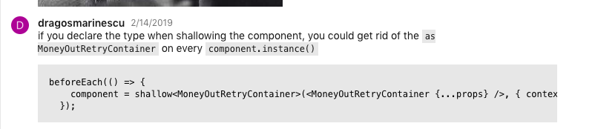
Tip 5: give code examples
Can leave as a comment, or give the suggested change as a branch off of theirs

Slide 12
Tip 6: Avoid using “you” in comments.
It makes it sound like a critique of the person and not the code.
Just write the proposed change
Use “we” which makes it sound more like a collective team effort.
Use passive voice “should be, could be”
Phrase as a question “what about, how about, could we?”

Slide 13
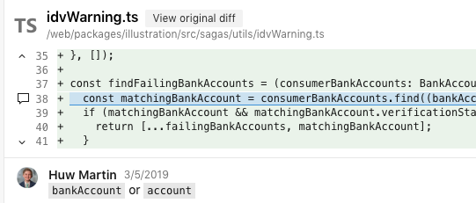
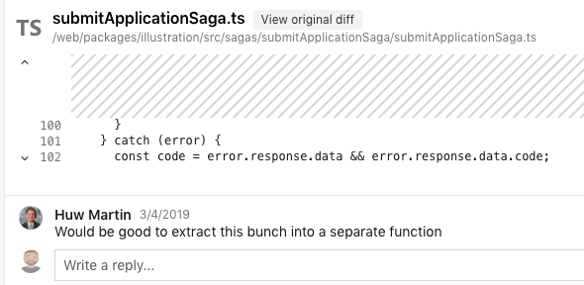

Slide 14
Tip 7: Avoid commands
e.g. “Remove this, don’t use that, move this up”.
Instead “Could/can we remove this, etc.”
Requests/questions give authors the sense of autonomy and make it easier for them to justify deliberate decisions and approach. If they argue with a command, it comes across as disobedience. If it’s a question, it’s input into a discussion.

Slide 15
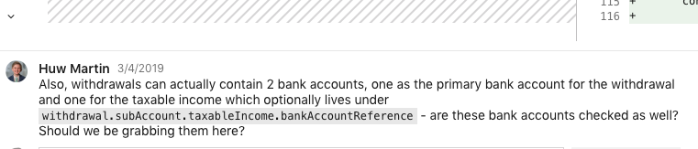
Tip 8: Give context
It’s possible you have background knowledge the reviewee doesn’t, e.g.

Slide 16
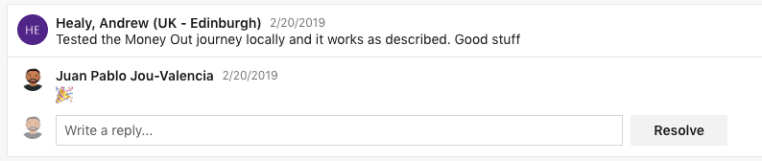
Tip 9: Recognition/praise
Give recognition where it is due!

Slide 17
Tip 10: Limit feedback on repeated patterns
If the same error occurs several times, don’t flag every single instance. Call out the first two-three, for more just ask the author to fix the pattern.

Slide 18
Tip 11: Respect the scope
If the change list doesn’t touch the line, it’s out of scope.
The exception is when the change list affects the surrounding code without actually touching it.

